Slide 1
Introduction to Peer Support
- Building a Peer Movement
Session 1:
What is Peer Support?
Notes:
Slide 1 – Introduction to Peer Support
Slide description:
Introduction to Peer Support – What is Peer Support?
Time:
Until you start.
Why:
This is simply a placeholder, something to have up as people arrive.

Slide 2
Acknowledgement of Country
Aboriginal and Torres Strait Islander Peoples
Notes:
Slide 2 - Acknowledgement of Country
Slide description: Acknowledgement of Country
(Image description: A Map of Australia and a more detailed Map of the Torres Strait)
Time:
2- 3 minutes
Purpose:
Start every session by remembering that you are meeting on Aboriginal land.
Main Points:
This is about showing respect to Aboriginal people and making sure that any Aboriginal people in the room feel welcome.
Find out whose country you are on before the session.
If there is an Aboriginal or Torres Strait Islander person in the room ask them before you start if they want to do acknowledgement of or welcome to country. If they are an Elder of the Country you are on they can do welcome to country.
Things to watch out for:
You might be on country that is owned by many different people. If you are not sure, make your acknowledgement general.

Slide 3
Housekeeping
Exits and emergencies
Bathrooms (including accessible bathrooms)
Phones
Breaks
Notes:
Slide 3 – Housekeeping
Slide description:
Housekeeping, Exits and emergencies, Bathrooms (including accessible bathrooms), Phones, Breaks
Time:
2 minutes
Why:
To make sure everyone knows about the venue, the breaks for the session and to turn their phones off.
Main Points:
Introduce yourself to the group and say where you are from.
Make sure you knows the emergency procedure and where the bathrooms are.
If you are having a break, you might let people know when, or you might say that there will be a morning tea break, a lunch break and a short break in the afternoon.

Slide 4
Our Purpose
“Be the change you want
to see in the world”
Mahatma Gandhi
Notes:
Slide 4 – Our Purpose
Slide description:
Our Purpose: “Be the change you want to see in the world” - Mahatma Gandhi
Time:
2 minutes
Why:
Motivate the group and focus the attention.
Main Points:
Let the group know that we are here today to learn about peer support.
Read out the quote.
The quote talks says that we can all create positive change in the world.
Talk about what the quote means to you.
Talk about how making positive change is what we are here to do today.
Watch out for:
Don't spend too much time on the quote. It might not work for everyone.

Slide 5
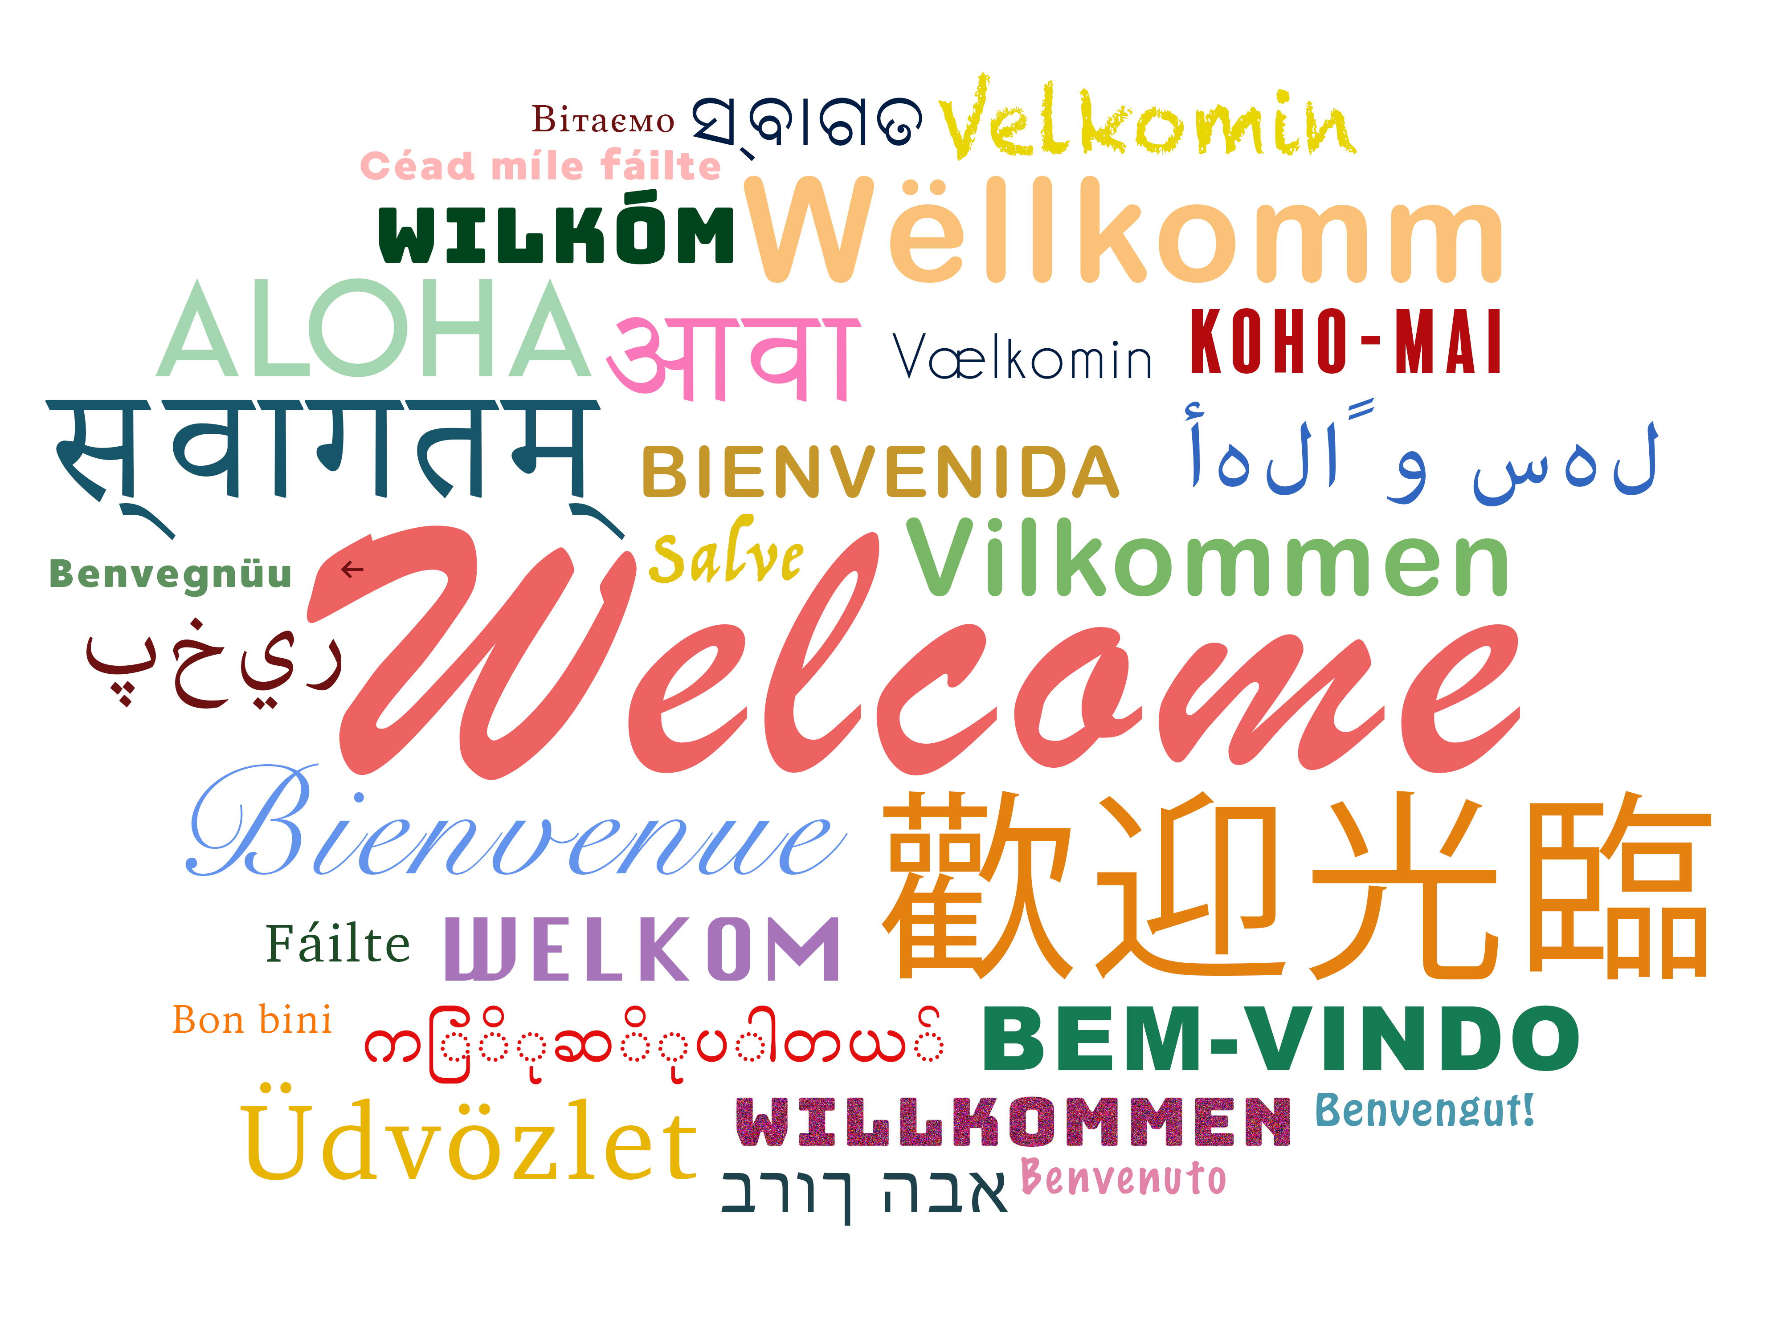
Notes:
Slide 5 – Welcome
Slide description:
Welcome.
(Image Description: the word welcome in many different languages and colours)
Time:
15-20 minutes
Why:
So that people get to know each other and feel welcome.
Main Points:
Peer support starts with getting to know one another.
Ask everyone to introduce themselves and say something about themselves.
Make sure that everyone in the room has a chance to speak. Very important.
Thank everyone for their contribution.
If you are going a bit over time, don't panic.
You can also try a simple ice-breaker, like asking people to introduce themselves and ask:
What is one thing that makes you happy?
And what is one thing you would like to get out of today?
For more ideas, read Introduction/ Welcome and Icebreakers in the Peer Facilitators Toolbox.
Things to watch out for:
Make sure everyone gets equal time to speak. Ask people to share one thing only.
The length of this exercise will depend on the size of your group.
This may be first time people are together and you will need to give time for them to get to know one another.
If you are going a bit over time, don't panic. You can simply push a bit faster through the content.

Slide 6
Pre Evaluation
Notes:
Slide 6 – Pre Evaluation
Note: only use this slide if you are evaluating this workshop.
Slide description:
Pre Evaluation.
(Image description: a hand holding a pen to fill out a form)
Time:
15 minutes
Why:
To improve the program for everyone.
Main Points:
Hand out any Pre Evaluation forms.
This evaluation form will help improve the program for everyone.
Please be honest and give us feedback.
It is not a test and it is not compulsory.
Extra Questions:
Does anyone need help filling in this form?
Things to watch out for:
Some people might feel uncomfortable filling this out or asking for help. Make sure someone is available to help.

Slide 7
What do you want to get out of this program?
Notes:
Slide 7 – What do you want to get out of this program?
Slide description:
What do you want to get out of this program?
Time:
5 minutes
Why:
To find out people’s expectations for the program.
Main Points:
Ask the group what they want to get out of the program.
Write all responses on a whiteboard / butcher’s paper.
Help people feel heard by repeating what they say.
Write Parking Lot at the top of another piece of butcher’s paper. If someone says something that you cannot cover, write it down here.
For more ideas, read about Expectations and the Parking Lot in the Peer Facilitators Toolbox.
Extra Questions:
If you walked away with one thing after today, what would that be?
Things to watch out for:
Some people might want something different. That’s okay! Make some time at the end of the day for people to talk about what they want. This is peer support in action!

Slide 8
Introduction to Peer Support?
Part 1: Why Peer Support?
Part 2: How to build a Peer Movement?
Part 3: What skills do I need?
Notes:
Slide 8 – Introduction to Peer Support
Slide description:
Introduction to Peer Support. Part 1: Why Peer Support? Part 2: How to build a Peer Movement? Part 3: What skills do I need?
Time:
2-5 minutes
Why:
Provide an overview of the whole training.
Main Points:
This training is made up of three different sessions.
Session 1 covers what peer support means and why it is important.
Session 2 covers what a peer movement is and how to make it happen.
Session 3 covers the most important skills for doing peer support.
Extra Questions:
Any questions? It is good to check people’s understanding early on. Make sure people feel they can ask questions.
Things to watch out for:
Don’t spend too much time on this slide, it is just an introduction. There will be time to go into detail later on.

Slide 9
How we work together
We start together on time and finish on time
We take responsibility for our own learning
We support each other to learn
We hold each other to account
We are respectful of each other
We are focused on learning
We are community – we look out for each other
…….. ?
Notes:
Slide 9 – How we work together
Slide description:
How we work together: We start together on time and finish on time; We take responsibility for our own learning; We support each other to learn; We hold each other to account; We are respectful of each other; We are focused on learning; We are community – we look out for each other …….. ?
Time:
Depends on number of people, no more than 10 minutes.
Why:
To set ground rules about what to expect from each other.
Main Points:
Before showing the slide, ask the group to tell you how they want to work together today.
Write down each person’s suggestion.
If the group runs out of ideas, go through the slide.
Talk about respect and confidentiality (see Peer Facilitators Toolbox for more information).
Check that everyone agrees with the list of ground rules before moving on.
Questions you might like to ask:
Is it ok to interrupt each other? Can we talk about everything we say here to other people? What should we do when we get stuck on something?
Things to watch out for:
Allow for conversations but keep an eye on the time.

Slide 10
Session 1: What is Peer Support?
What does the word Peer mean?
Who is a Peer?
What is Peer Support?
Where and when can Peer
Support happen?
In what areas of life can Peers
support each other?
Notes:
Slide 10 – What is Peer Support?
Slide description:
What does the word peer mean? Who is a peer? What is peer support? Where and when can peer support happen? In what areas of life can Peers support each other?
Time:
2-3 minutes
Why:
Provide an overview of the first session.
Main Points:
These are the questions that we will cover in the first session.
Read through the questions on the slide.
Things to watch out for:
If people tell you that they have come because they are looking for some peer support right now, it might be useful to say something like:
“This program is about learning about what peer support is and how to give it. If anyone wants more time to practice peer support, we can spend 10 minutes during lunch or at the end of today talking about setting up a peer support group.”

Slide 11
A Peer is…
a person who belongs to the same group maybe because of
Age
Where they live
Where they are from
The kind of work they do
… more ?????
Notes:
Slide 11 – A Peer is
Slide description:
A Peer is... a person who belongs to the same group maybe because of age, where they live, where they are from, the kind of work they do
Time:
5 minutes
Why:
Find out from the group about what they think a peer is
Main Points:
The slide gives a definition of who a peer is
Ask the group for their ideas about who a peer is
Ask about the difference between a peer and a friend, or a peer and a family member
Extra Questions:
Are a boss and the person who works for the boss peers?
Are parents and their children peers?
Tips:
Keep your questions open ended.
This is an opportunity for the group to share what they think a peer is.

Slide 12
Who is a Peer?
A person who is equal to another person
A person who has similar experiences as another person
.. Who are the Peers
in the room today?
Notes:
Slide 12 – Who is a Peer?
Slide description:
Who is a Peer? A person who is equal to another person; a person who has similar experiences as another person... Who are the Peers in the room today?
Time:
3-5 minutes
Why:
Create a shared understanding of the word peer.
Main Points:
Talk about how peers are equals with one another
Talk about how peers share similar experiences or have things in common
Some people will connect as peers because of their disability
Others will connect because of similar interests
Extra Questions:
How many people were born in Sydney?
How many people who speak another language?
How many people who go to country music festivals?
Watch out for:
Make sure the conversation does not become about ‘us and them’, but is about finding common ground.

Slide 13
What is Peer Support?
Peers sharing with each other
What they know
things that worked
things that didn’t work
things you have learned
.. and sometimes it’s about finding out something new together
Notes:
Slide 13 – What is Peer Support?
Slide description:
Peers sharing with each other: what they know; things that worked; things that didn’t work; things you have learned; and sometimes it’s about finding out something new together
Time:
10 minutes
Why:
Explore the meaning of peer support.
Main Points:
Ask participants to share some stories about people supporting each other
Have some of your own peer support stories to share
Extra Questions:
This might be a bit tough, so you might like to ask easier questions. "Have you ever supported someone? Has there ever been a time in your life where you got support from someone who was not paid for that support?"
Watch out for:
Make sure you are not talking traditional, paid disability or medical supports. That is not peer support. Keep going back to people who are equals and who are in similar situations.

Slide 14
Video - What is Peer Support?
Notes:
Slide 14 – Video – What is Peer Support?
Slide description:
Video - What is Peer Support?
Time:
10 minutes
Why:
Learn more about what peer support means.
Main Points:
Play the video What is Peer Support
Ask participants what they thought of the video.
What did the people in the video say about peer support?

Slide 15
Who is the EXPERT in your life?
An expert is someone who
knows a lot about something.
Who knows most about
you or your family?
Notes:
Slide 15 – Who is the expert in your life?
Slide description:
Who is the expert in your life? An expert is someone who knows a lot about something. Who knows most about you or your family?
Time:
5 minutes
Why:
To build people’s confidence as experts in their own lives.
Main Points:
If people say straight away that they are the experts in their own lives, you can move straight on to the next slide.
If not, then have a discussion with the group.
People who are not peers may also know a lot and can assist, guide and support.
This is important too, but it is not peer support and they are not the expert on your life.
Extra Questions:
Who knows most about your life?
Who knows best about what you like and don’t like? What works for you and what doesn’t work for you?
If you have family members in the room, you ask a question that includes them.
Things to watch out for:
If people don't know that they are the experts in their own life, you can ask other people in the group to talk about what being an expert means to them.
The group might get stuck talking about who knows best, the person with the disability or their family member.
You can say,
“Everyone knows what is best for themselves, but sometimes we get it wrong and that we need strong support from people who love us to help us find the best decisions for ourselves.”
If that conversation gets too difficult, it is best to go back the respect part in the ‘How we work together’ section.
Or you can say,
“Being respectful of each other means that we respect each other’s opinions and that we are all coming from wanting people with disability to have a great life. Making decisions, being in charge of one’s own life and having as much choice and control as possible is part of a great life. The role of any family member or friend is to work together with the person with the disability to try and figure out how to best support the person with the disability to do that.”

Slide 16
An expert get together
when two or more peers get together and talk about what we know best and support each other
Notes:
Slide 16 – An expert get together
Slide description:
An expert get together: when two or more peers get together and talk about what we know best and support each other
Time:
3 minutes
Why:
To build people’s confidence in other people who are also experts in their own lives.
Main Points:
Introduce the idea as experts, when we get together we have a meeting of experts!
Remember peers are equals. This means that no one is more important than anyone else.
Watch out for:
This idea might not work for everyone. That’s okay, some people might need more time to think about it. Just move on.

Slide 17
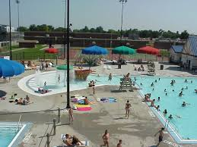
Where and when can Peer Support happen?
Anywhere, Anytime!
Notes:
Slide 17 – Where and when can peer support happen?
Slide description:
Where and when can Peer Support happen? Anywhere,
Anytime!!
(Image Description: a street, a supermarket, a coffee shop, a public pool)
Time:
5 minutes
Why:
To show that peer support can be a way of life, not just something we do in a formal group.
Main Points:
There are lots of different ways of doing peer support
It does not have to be a formal meeting or a group
It can happen anywhere, anytime!
Give some examples of peer support in action in informal or public settings
Things to watch out for:
Try to keep this easy and practical.
One of the concerns people might have is "What will other people think of me?"
Encourage people to be brave! And to remember that every action counts towards building a peer movement.

Slide 18
In what areas of life can peers support each other?
How to employ a support worker
Living independently
Booking concert tickets
Getting the most of my NDIS plan
How to prepare for a job interview
Anything!
Notes:
Slide 18 – In what areas of life can peers support each other?
Slide description:
In what areas of life can peers support each other? How to employ a support worker; living independently; booking concert tickets; getting the most of my NDIS plan; how to prepare for a job interview… Anything.
Time:
10 – 15 minutes
Why:
Broaden the way that people think about peer support.
Main Points:
Peer support can be about anything.
Sometimes disability can be the starting point for peer support. But it doesn't have to be only about disability. There is more to people's lives than their disability!
Write the following questions on a white board
What parts of your life would like to get support in or give someone else support?
What are you interested in learning from a peer?
What experiences have you had that a peer might like to hear about?
What are you good at?
Give people 5 minutes to sit in pairs and discuss these questions.
When they are finished, ask people to share their ideas with the group.
Make sure everyone who wants to share gets a chance.
Write down people’s comments on butcher’s paper or the whiteboard.
Watch out for:
Sometimes it can be tricky for people to think about what they can offer. If they cannot come up with anything, ask the group of what they think a particular person in the room has got to offer? This can become a nice opportunity for people to appreciate another peer and what they bring to the group.
To learn more check out ‘Group work’ in your Peer Facilitators Toolbox.

Slide 19
Next session
How to build a Peer Movement?
Growing Peer Support
everywhere
everytime
Together with more people
Notes:
Slide 19 – Next Session
Slide Description
Next Session. How to build a Peer Movement?
Growing Peer Support, everywhere, everytime, together with more people
Time:
2 minutes
Why:
Get people thinking about next session
Main Points:
Introduce the topics for the next session, Building a Peer Movement
A Peer Movement is about the big picture and how doing peer support is creating change.
Get people excited about the next session

Slide 20
For next week
Practice Peer support
Think about who your Peers are (make a list)
Have a conversation with a Peer
Ask for or offer some support to a Peer
Come back next week to share your experiences with your Peers here!
Notes:
Slide 20 – For next week
Slide Description:
For next week. Practise Peer support, Think about who your Peers are (make a list), Have a conversation with a Peer, Ask for or offer some support to a Peer, Come back next week to share your experiences with your Peers here!
Time:
5 minutes
Why:
People start to practice what they have learned about peer support in their lives.
Main Points:
To get good at something everyone needs to practice.
Ask the group to do at least two peer tasks before next week. The slide gives some examples.
Make a list of the peers in your life.
Find a peer to talk to
Ask for or offer some peer support.
If you think you don’t have a peer, make sure you connect with someone from here before you leave. Grab a phone number and/or make a time for a coffee.
Come back next week and share with the group.

Slide 21
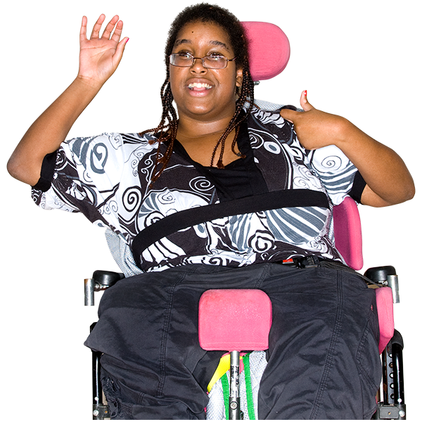
Check out
Notes:
Slide 57 – Check-out
Slide description:
Check out. (Image description: A woman using a wheelchair is waving and has her thumbs up)
Time:
5 minutes
Why:
To find out how people are feeling and their next steps.
Main Points:
A check-out helps find out how people are feeling at the end of the workshop.
It is also a very powerful way of building accountability and community.
Ask everyone to write down one word about how they are feeling at the end of the training and one next action from today’s training that they are going to take in peer support
Ask everyone to share their one word and action with the group
Make sure someone is available to write down people’s answers

Slide 22
Post Evaluation
Notes:
Slide 56 – Post Evaluation
Slide description:
Post evaluation
Time:
5 minutes
Why:
To get feedback on how to improve the program.
Main Points:
Hand out the Post Evaluation form.
This evaluation form asks people what they have learned from the session.
This is not a test.
It will help to improve the program for everyone.
Please be honest and give us feedback.

